Slide 1
Declan Woodham
1701185
BSc Ethical Hacking Third Year
Muzzle
App Demonstration

Slide 2

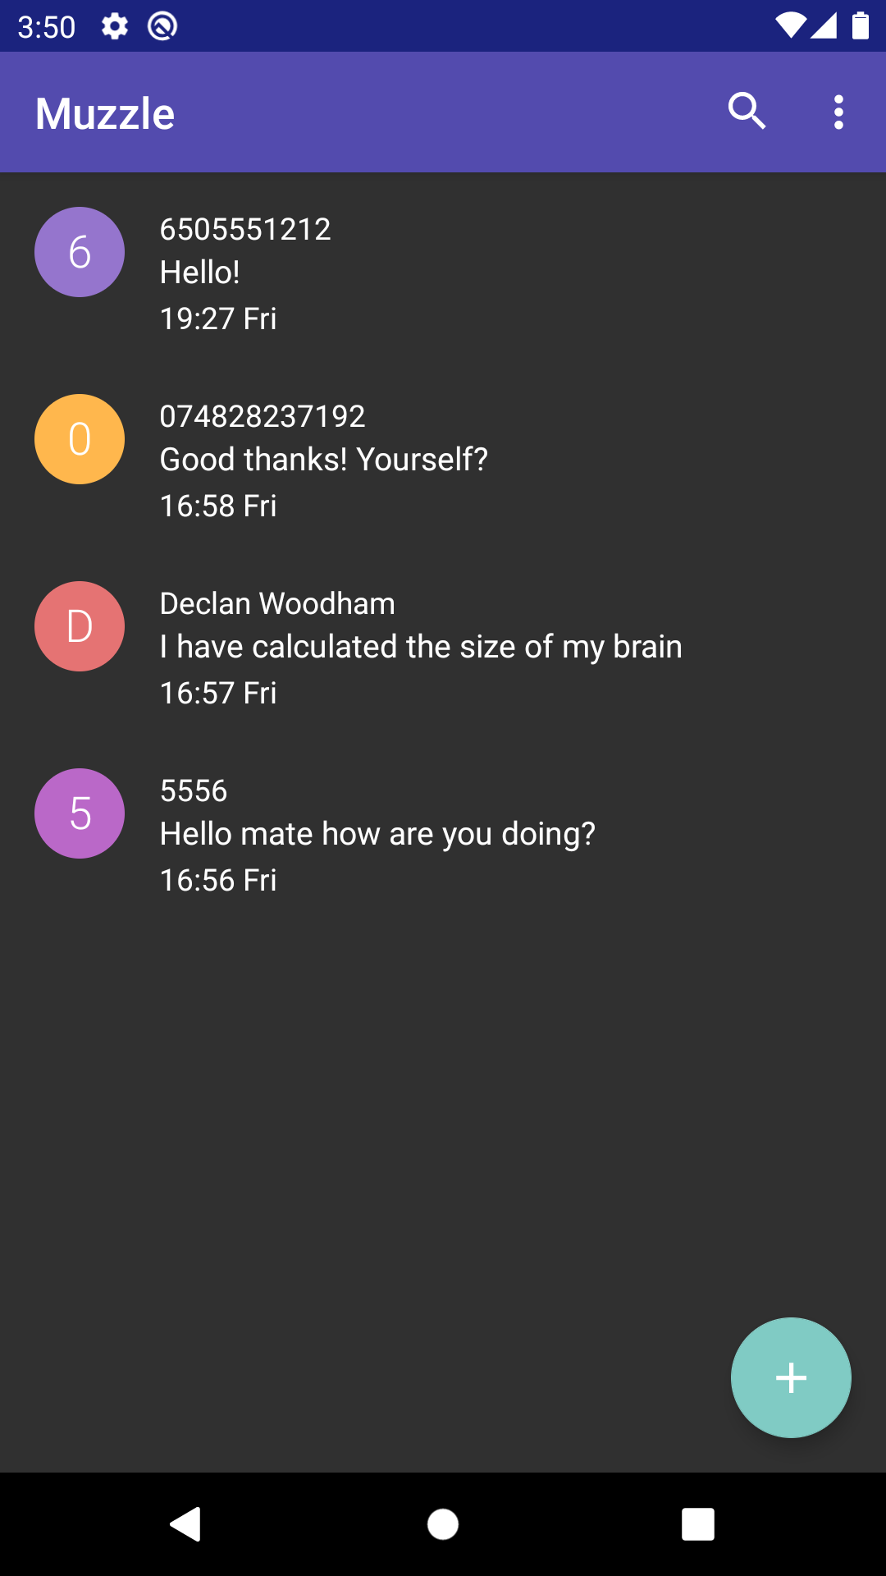



Overview
1
Encrypted Text Messaging App
Muzzle
A fully fledged text messaging app with support for fully encrypted messages to provide seamless secure text messages between other users of the app
Secure Messages
Android API
28+
256 Bit Encryption

Slide 3
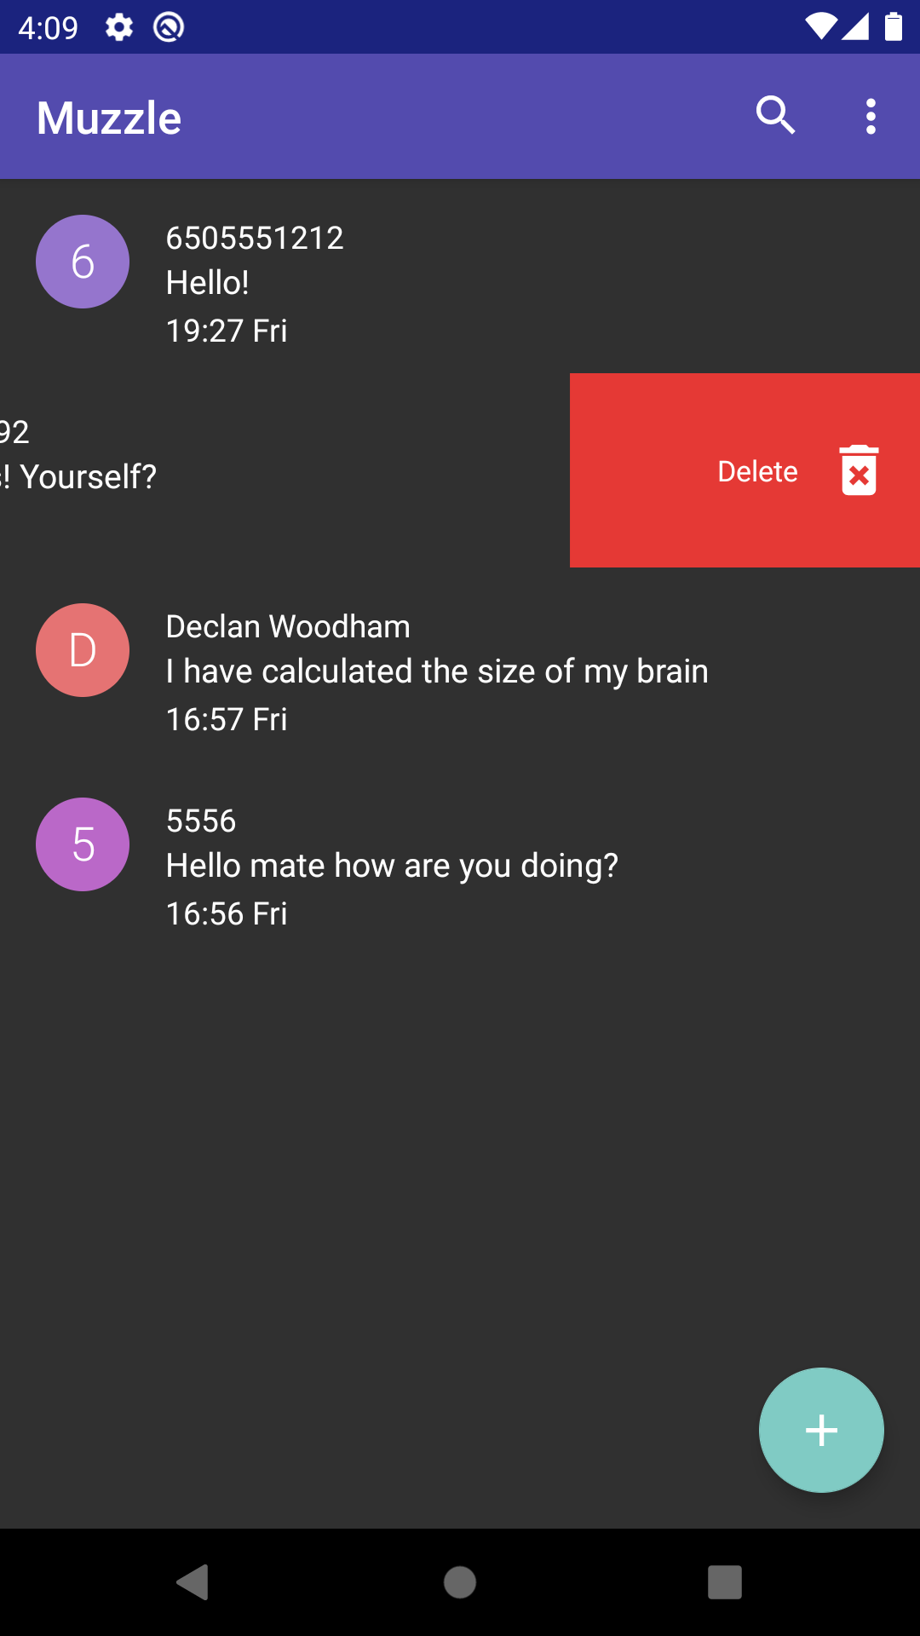
Conversation List
Swipe to hide conversation
View new messages
2

Slide 4
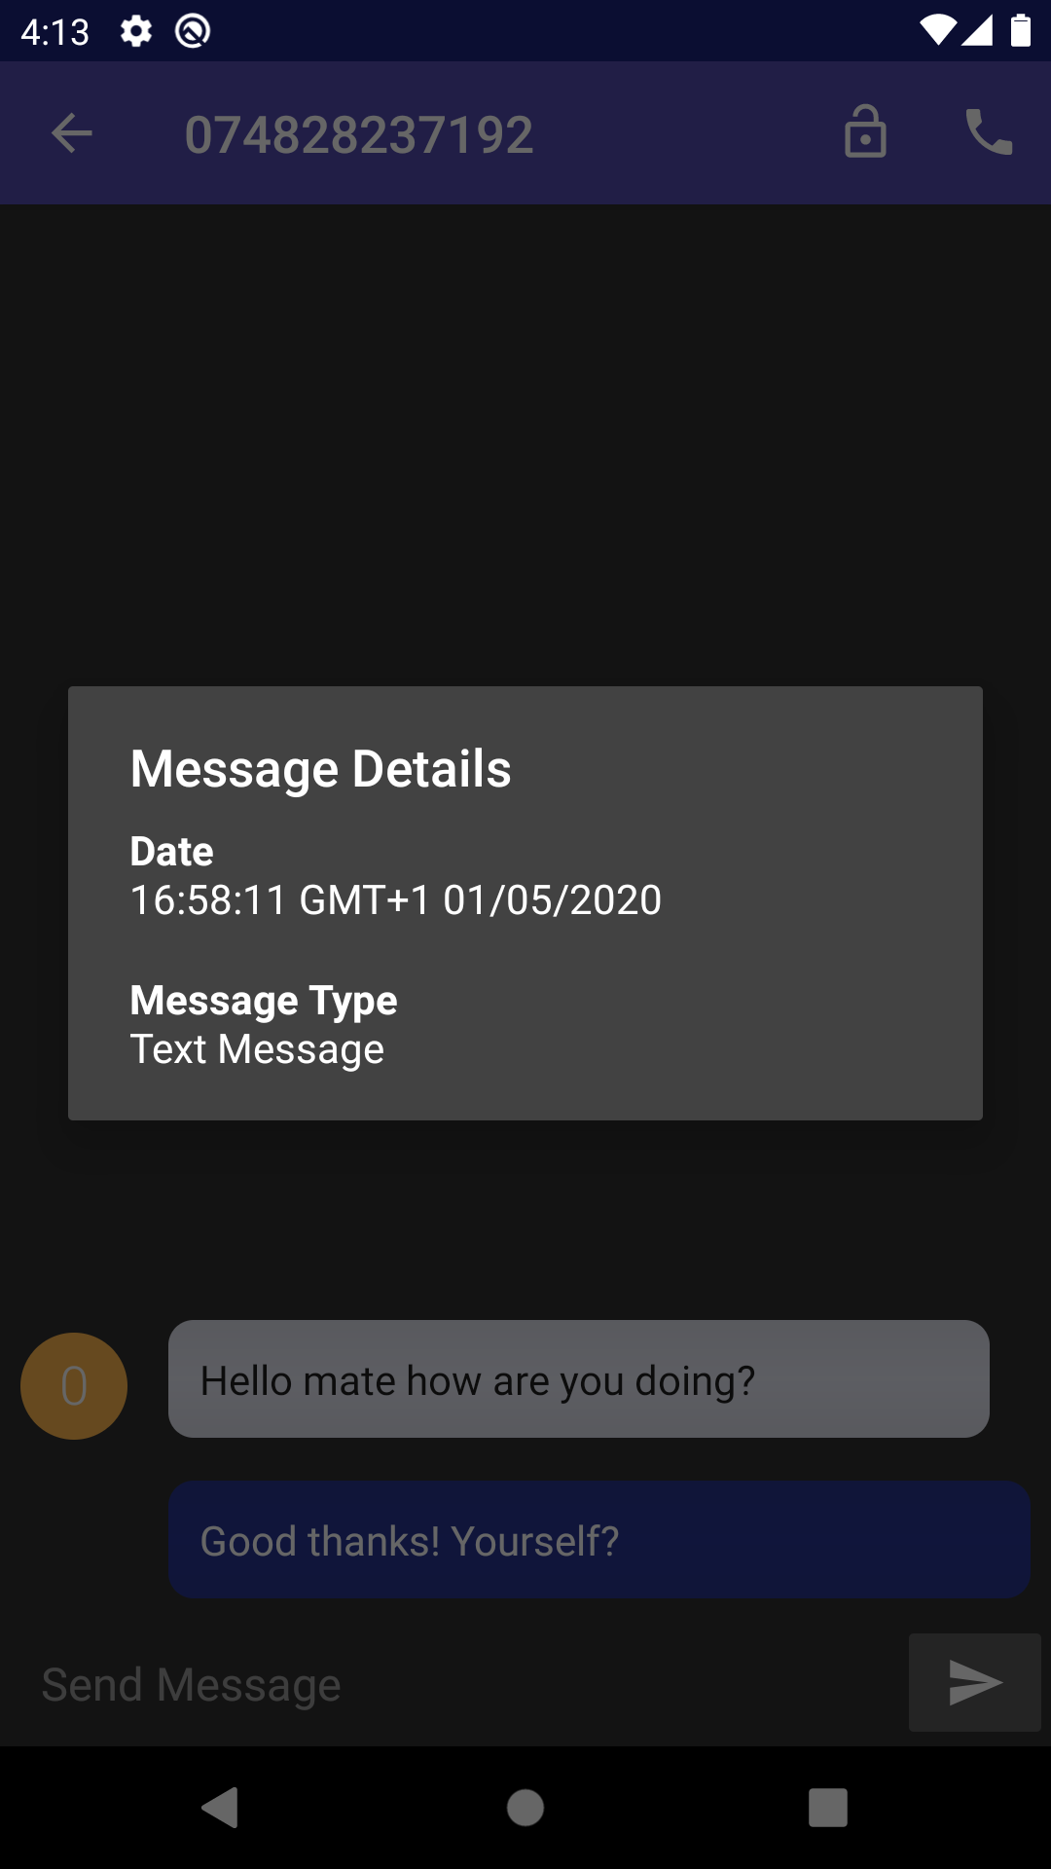
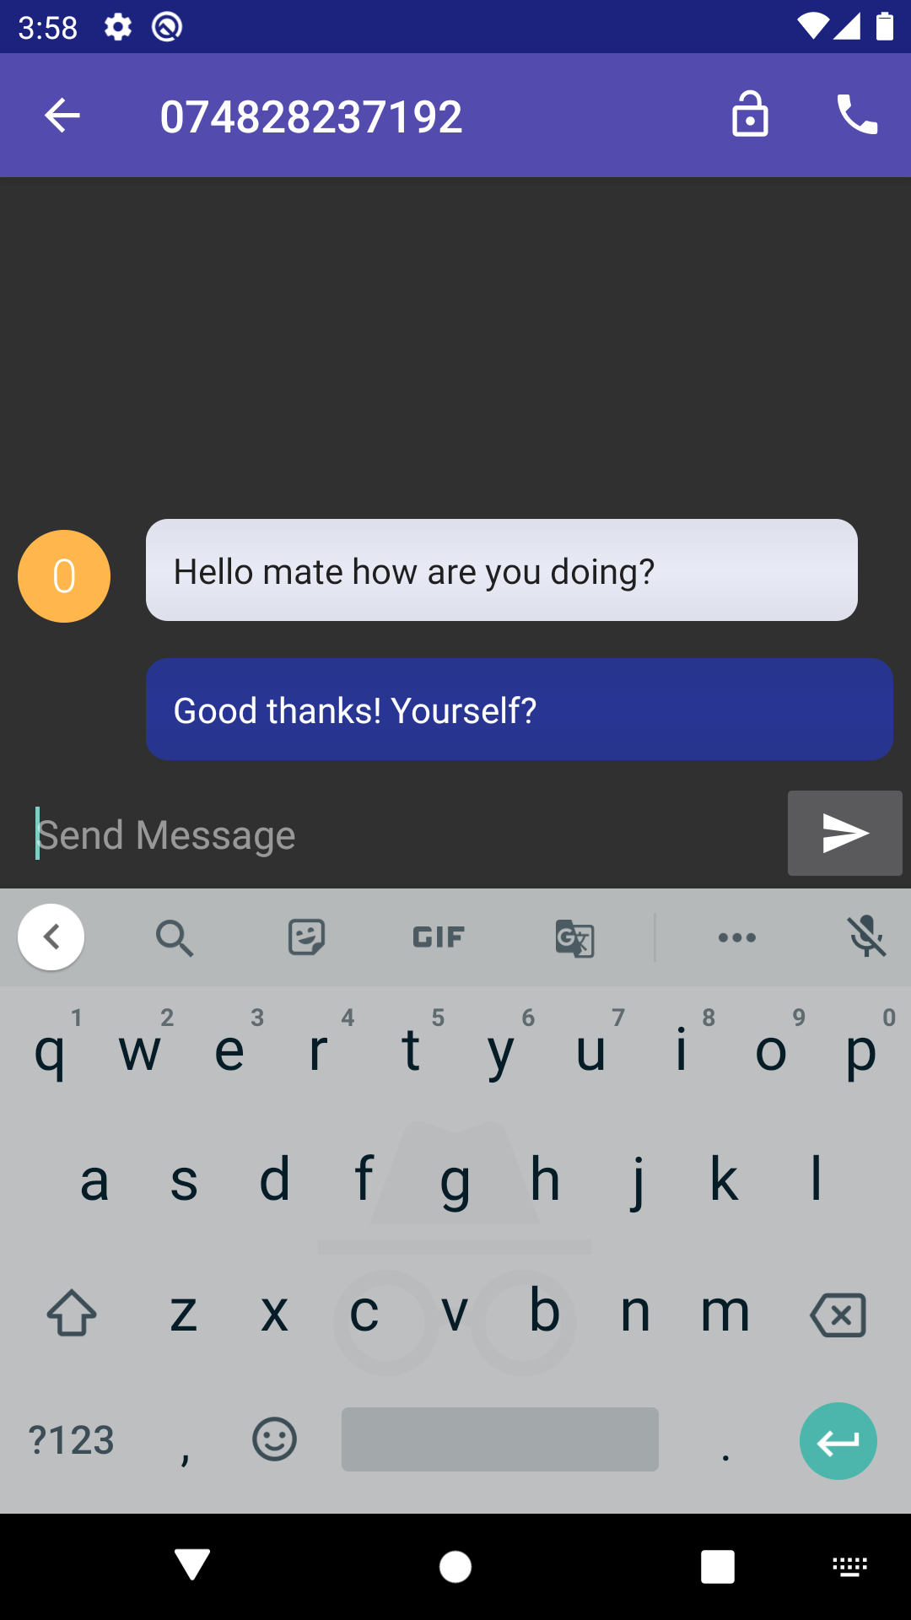
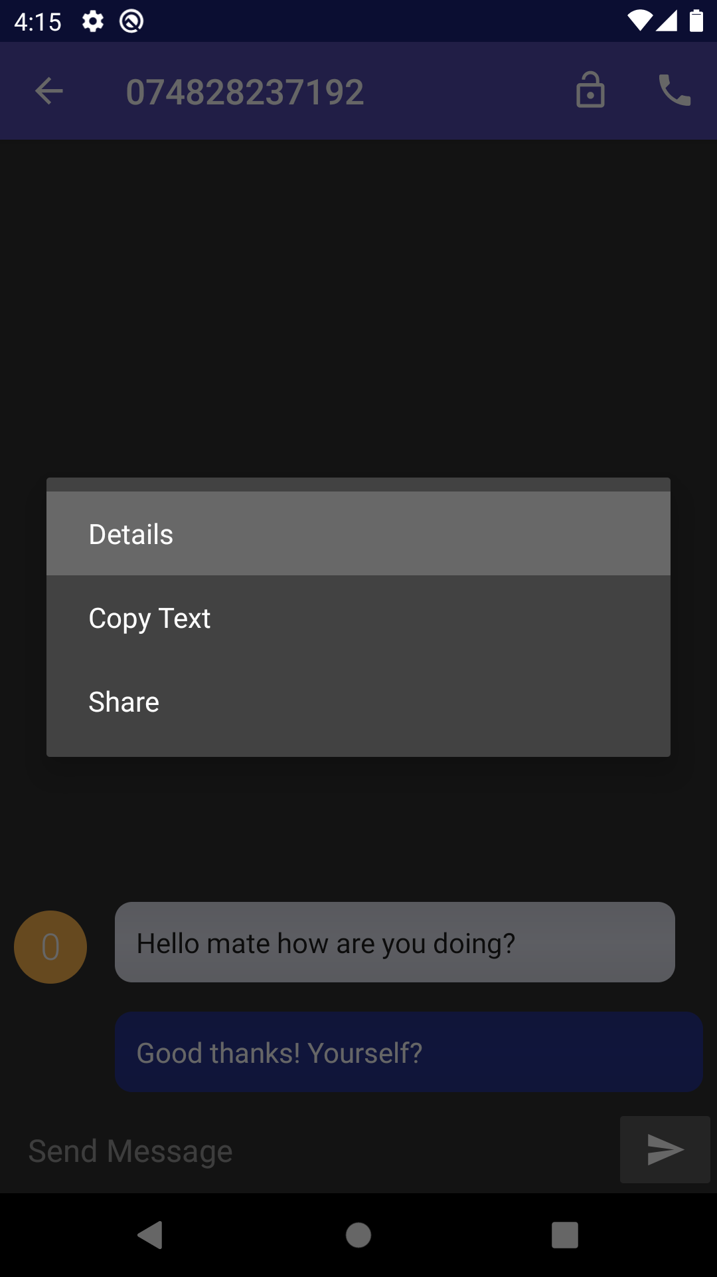
Conversations
3

Slide 5
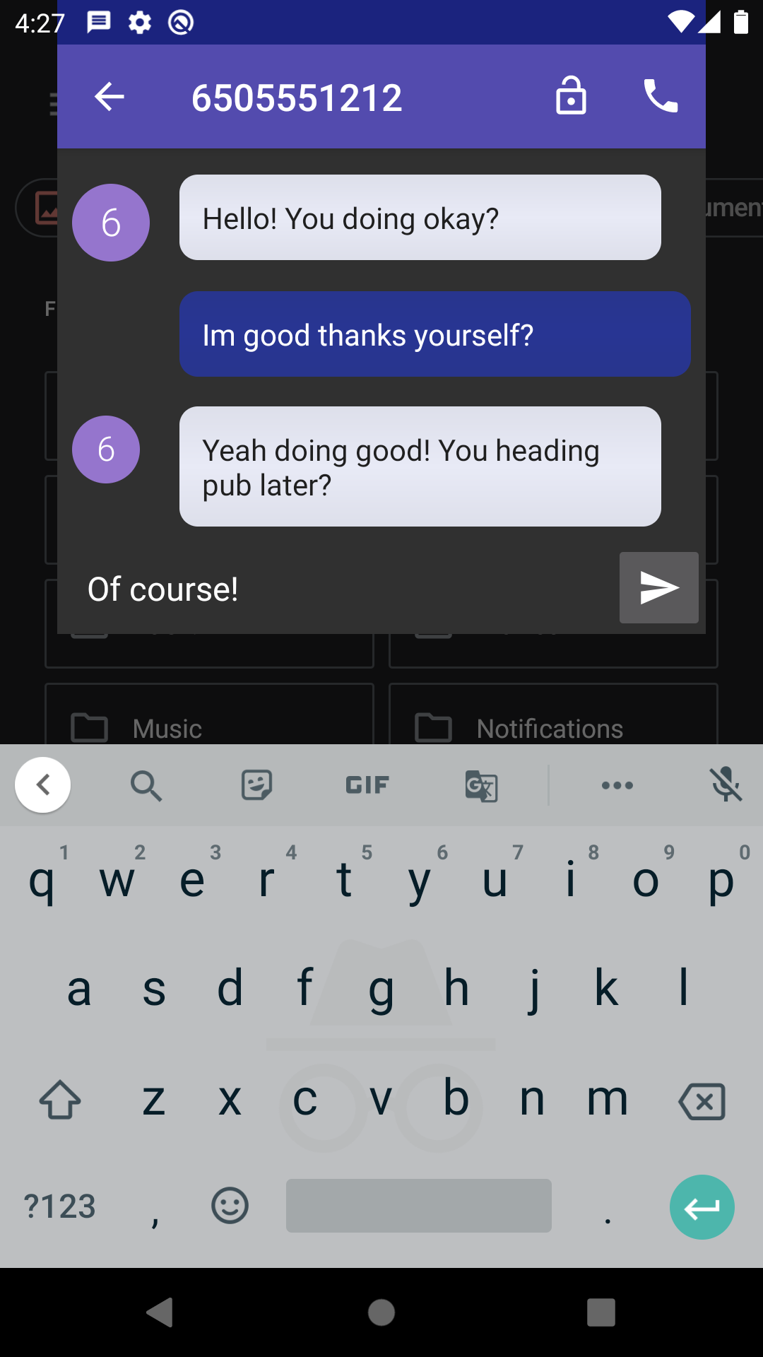
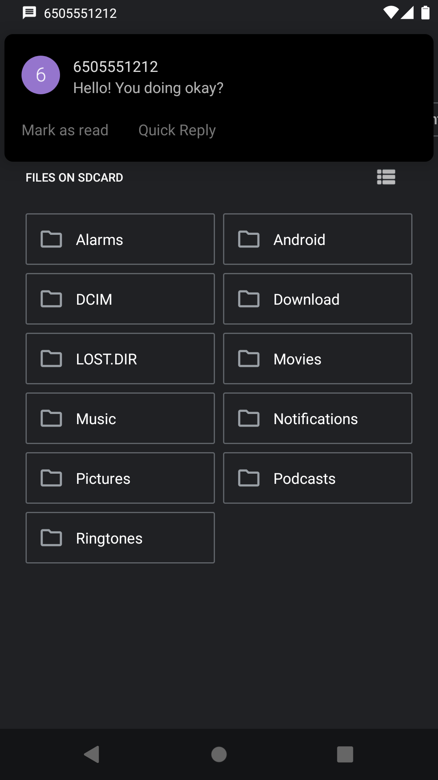
Notifications
Conversation Popup
Quick Reply
Mark Messages as Read
4

Slide 6
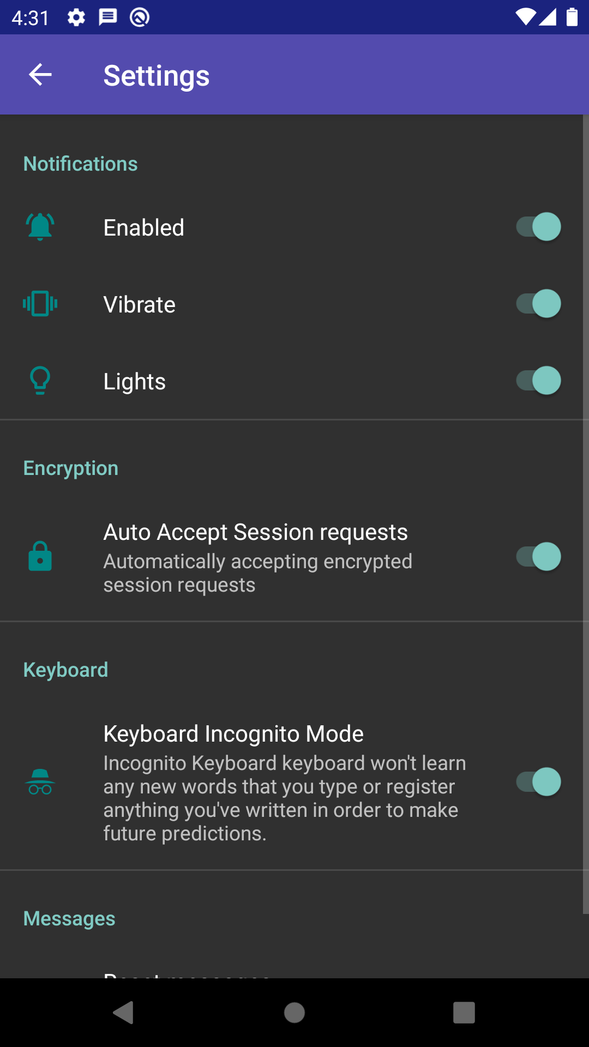
Settings
5

Slide 7
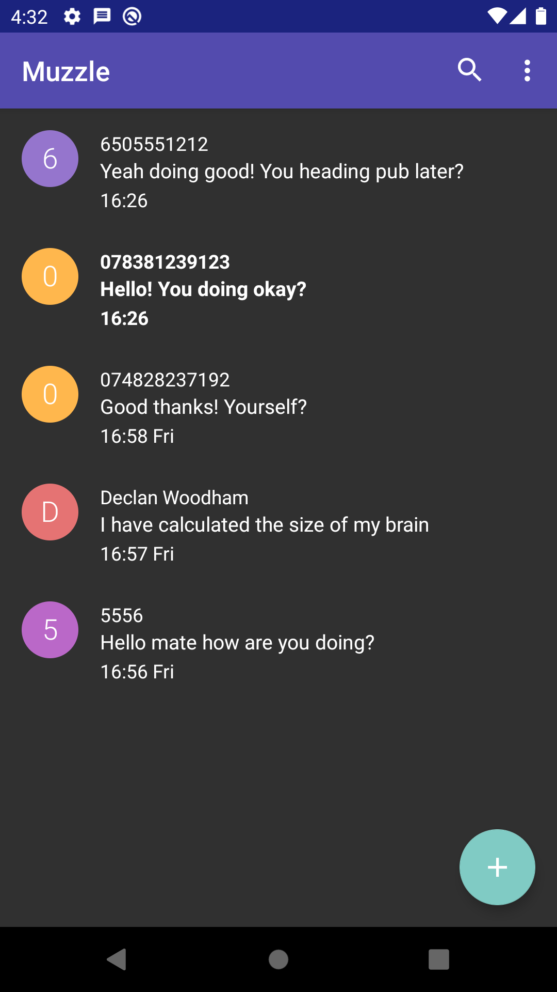
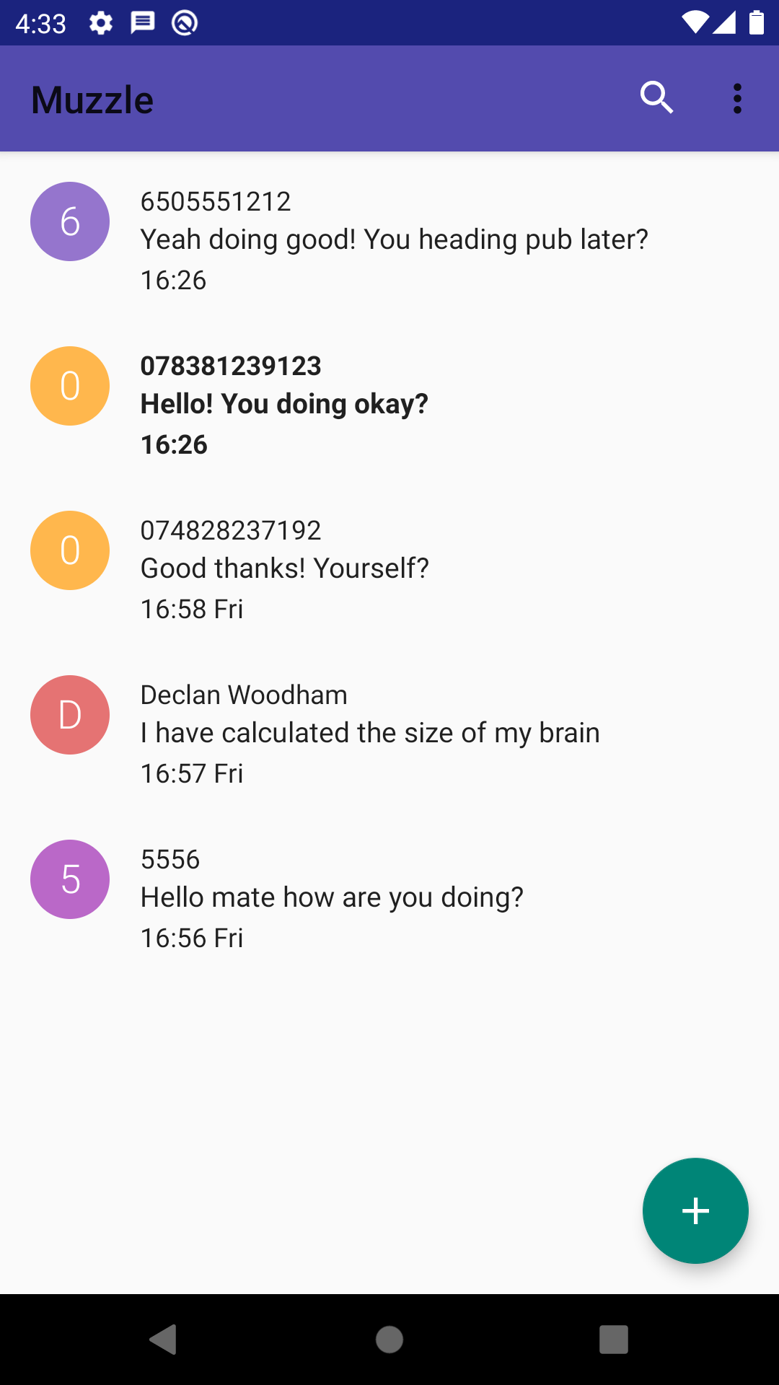
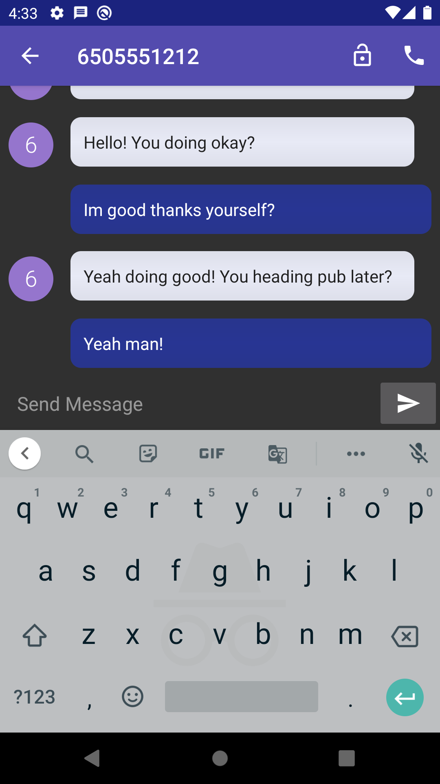
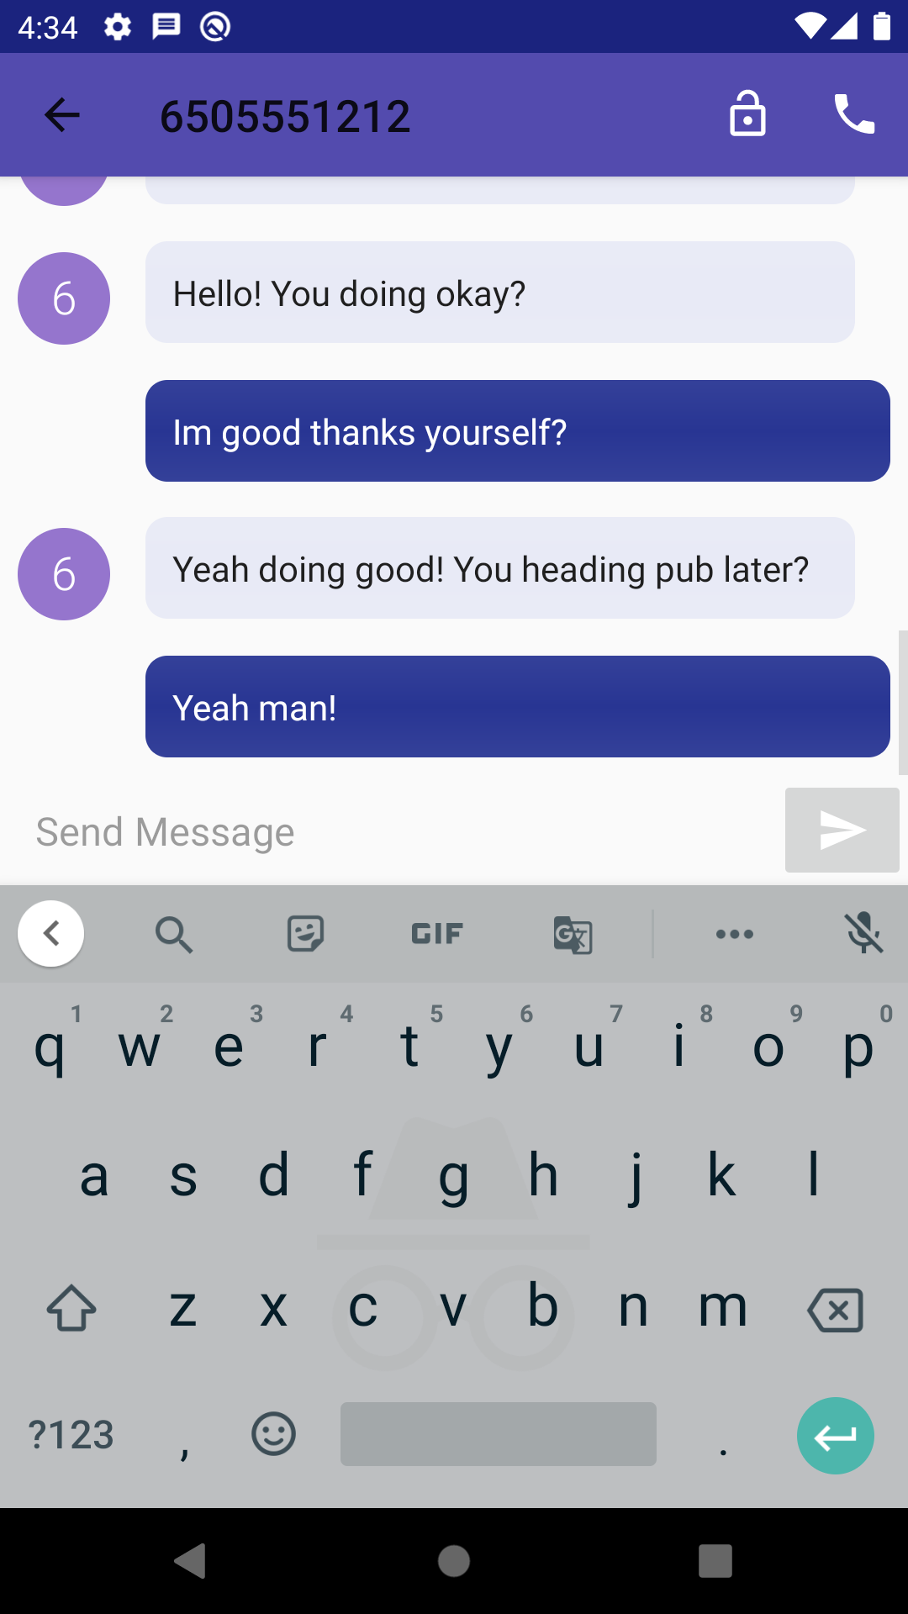
Themes
Supports Day and Night mode
6

Slide 8



Android API Features
7
API
Storage
Android X
Notifications
Telephony
SMS
Custom Broadcasts
Services
SQLite
Shared Preferences
Room
Data Binding
Life Cycle
Live Data

Slide 9
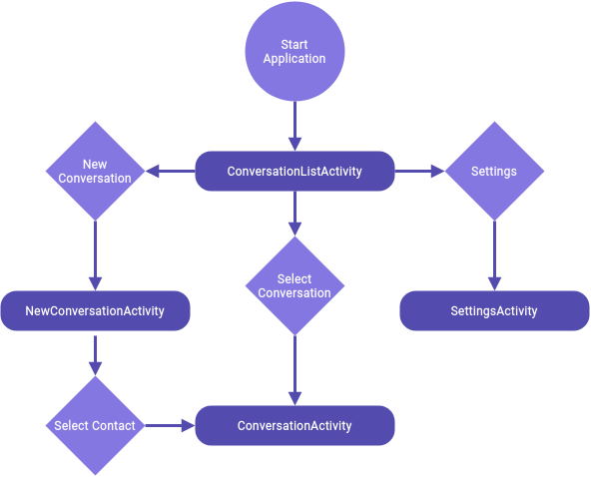
Activity Flow
8

Slide 10
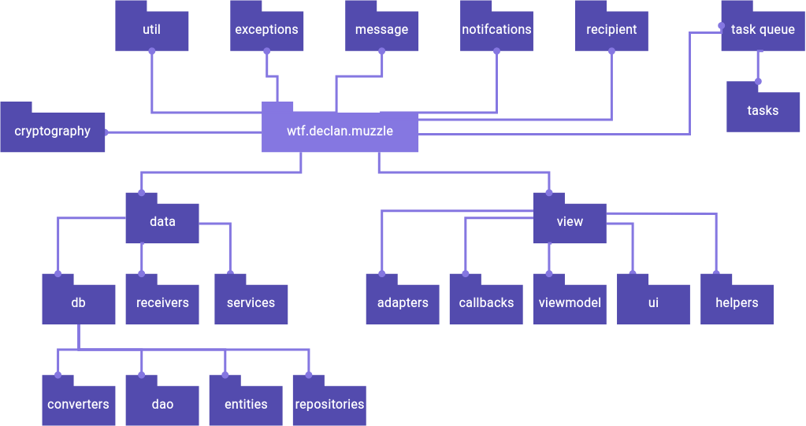
Package Structure
9

Slide 11
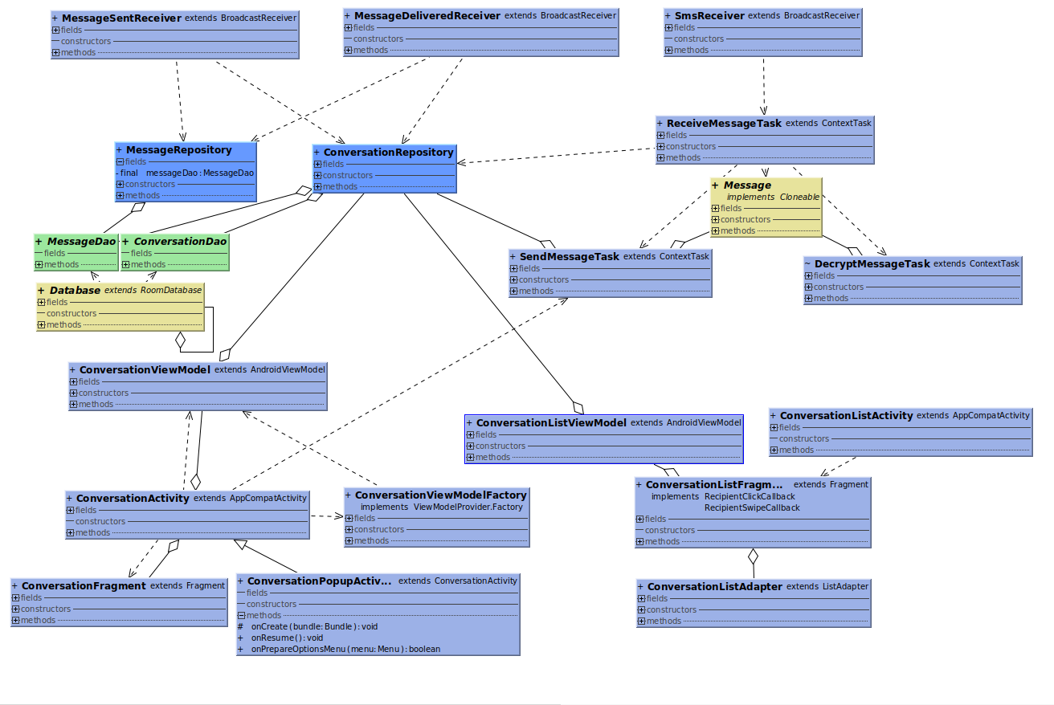
Database Interaction UML
10
Broadcasts
Database
Multithreaded Tasks
User Interface
Notes:
MMS Support
Allow support of images and videos
Currently android requires SMS apps to take total control over all sms content when becoming a default application. Currently there is no support within the app for multimedia messages such as photos and videos.
Contacts
Currently the app when creating a new conversation requires the telephone number to already be an existing contact. In future work, a dialpad could be implemented to allow users to create a conversation with any telephone number, whether they are saved or not.
Encryption Algorithms
Currently there is only one encryption algorithm implemented, with more research time, more cryptographically secure and safer encryption methods could be implemented. This would allow users in government or other organisations which require a certain qualified encryption method to use the application.
Furthermore, the popular signal lib could be implemented as it is verified as a secure protocol for messaging.
Dependency Injection
Currently the app does not implement any form of dependency injection. Dependency injection allows code to be

Slide 12
Database Structure
11
Conversations
Sessions
id | number | visible | session | read | updated
Auto Increment |  |  | @Embedded
Long | String | Boolean | Session | Boolean | Date
Primary Key
id | derived_key | public_key | private_key | recipient_public_key | session_date
Auto Increment
Long | String | Secret Key | ECPrivateKey | ECPublicKey | Date
Primary Key
ConversationEntity.java
SessionEntity.java
Messages
id | conversation_id | body | date | inbox | read | notified | delivered | sent | failed | type
Auto Increment | Relation
Long | Long | String | Date | Boolean | Boolean | Boolean | Boolean | Boolean | Boolean | MessageType
Primary Key
MessageEntity.java

Slide 13


Existing Issues
12
Race Condition
Messages
MMS Support
Issue with corrupted messages
and sessions
Arriving in wrong order
Longer messages failing to decrypt
Currently no support for images, video or audio messages

Slide 14


Future Work
13
MMS Support
Keypad Support
& Contacts
Encryption Algorithms
Dependency Injection
Unit Testing
Notes:
MMS Support
Allow support of images and videos
Currently android requires SMS apps to take total control over all sms content when becoming a default application. Currently there is no support within the app for multimedia messages such as photos and videos.
Contacts
Currently the app when creating a new conversation requires the telephone number to already be an existing contact. In future work, a dialpad could be implemented to allow users to create a conversation with any telephone number, whether they are saved or not.
Encryption Algorithms
Currently there is only one encryption algorithm implemented, with more research time, more cryptographically secure and safer encryption methods could be implemented. This would allow users in government or other organisations which require a certain qualified encryption method to use the application.
Furthermore, the popular signal lib could be implemented as it is verified as a secure protocol for messaging.
Dependency Injection
Currently the app does not implement any form of dependency injection. Dependency injection allows code to be

Slide 15


